Slide 1

Marketing Campaign Prediction
Metis Individual Project 3
Shuo Jia

Slide 2






Business Problem
Analytics Objective
Data Description
Hard to target potential buyers
Inefficient resource allocation for customer experience
Devise classification approach
Clarify important features
Analyze customer patterns
Client
Last contact of current campaign
Previous campaign

Slide 3





Methodology
Performance Metrics: F-beta Score
EDA
SMOTE Over Sampling
Hyper-Parameter Tuning
Model Evaluation
GridSearchCV
Model Interpretation
Business Suggestion
Model Building
Logistic Regression
Decision Tree
Random Forest
XGBoost
Model Selection
ROC
AUC

Slide 4
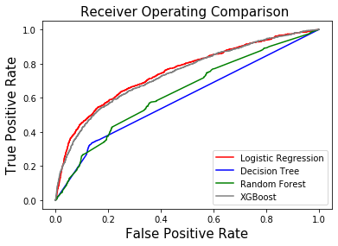
Model Evaluation and Selection
Model | F-beta | AUC | Best Parameter
Logistic Regression | 0.695 | 0.749 | C: 12
Decision Tree | 0.876 | 0.597 | max_depth 27
Random Forest | 0.904 | 0.632 | max_depth 25
XGBoost | 0.908 | 0.739 | max_depth 24

Slide 5
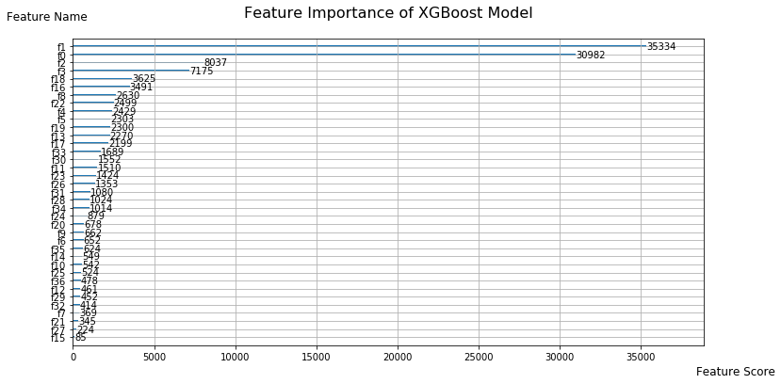
Model Interpretation
F1 | Balance
F0 | Age
F2 | Campaign
F3 | Pdays
F18 | Education - Secondary
F16 | Married
Notes:
pdays: number of days that passed by after the client was last contacted from a previous campaign
campaign: number of contacts performed during this campaign and for this client (numeric, includes last contact)

Slide 6
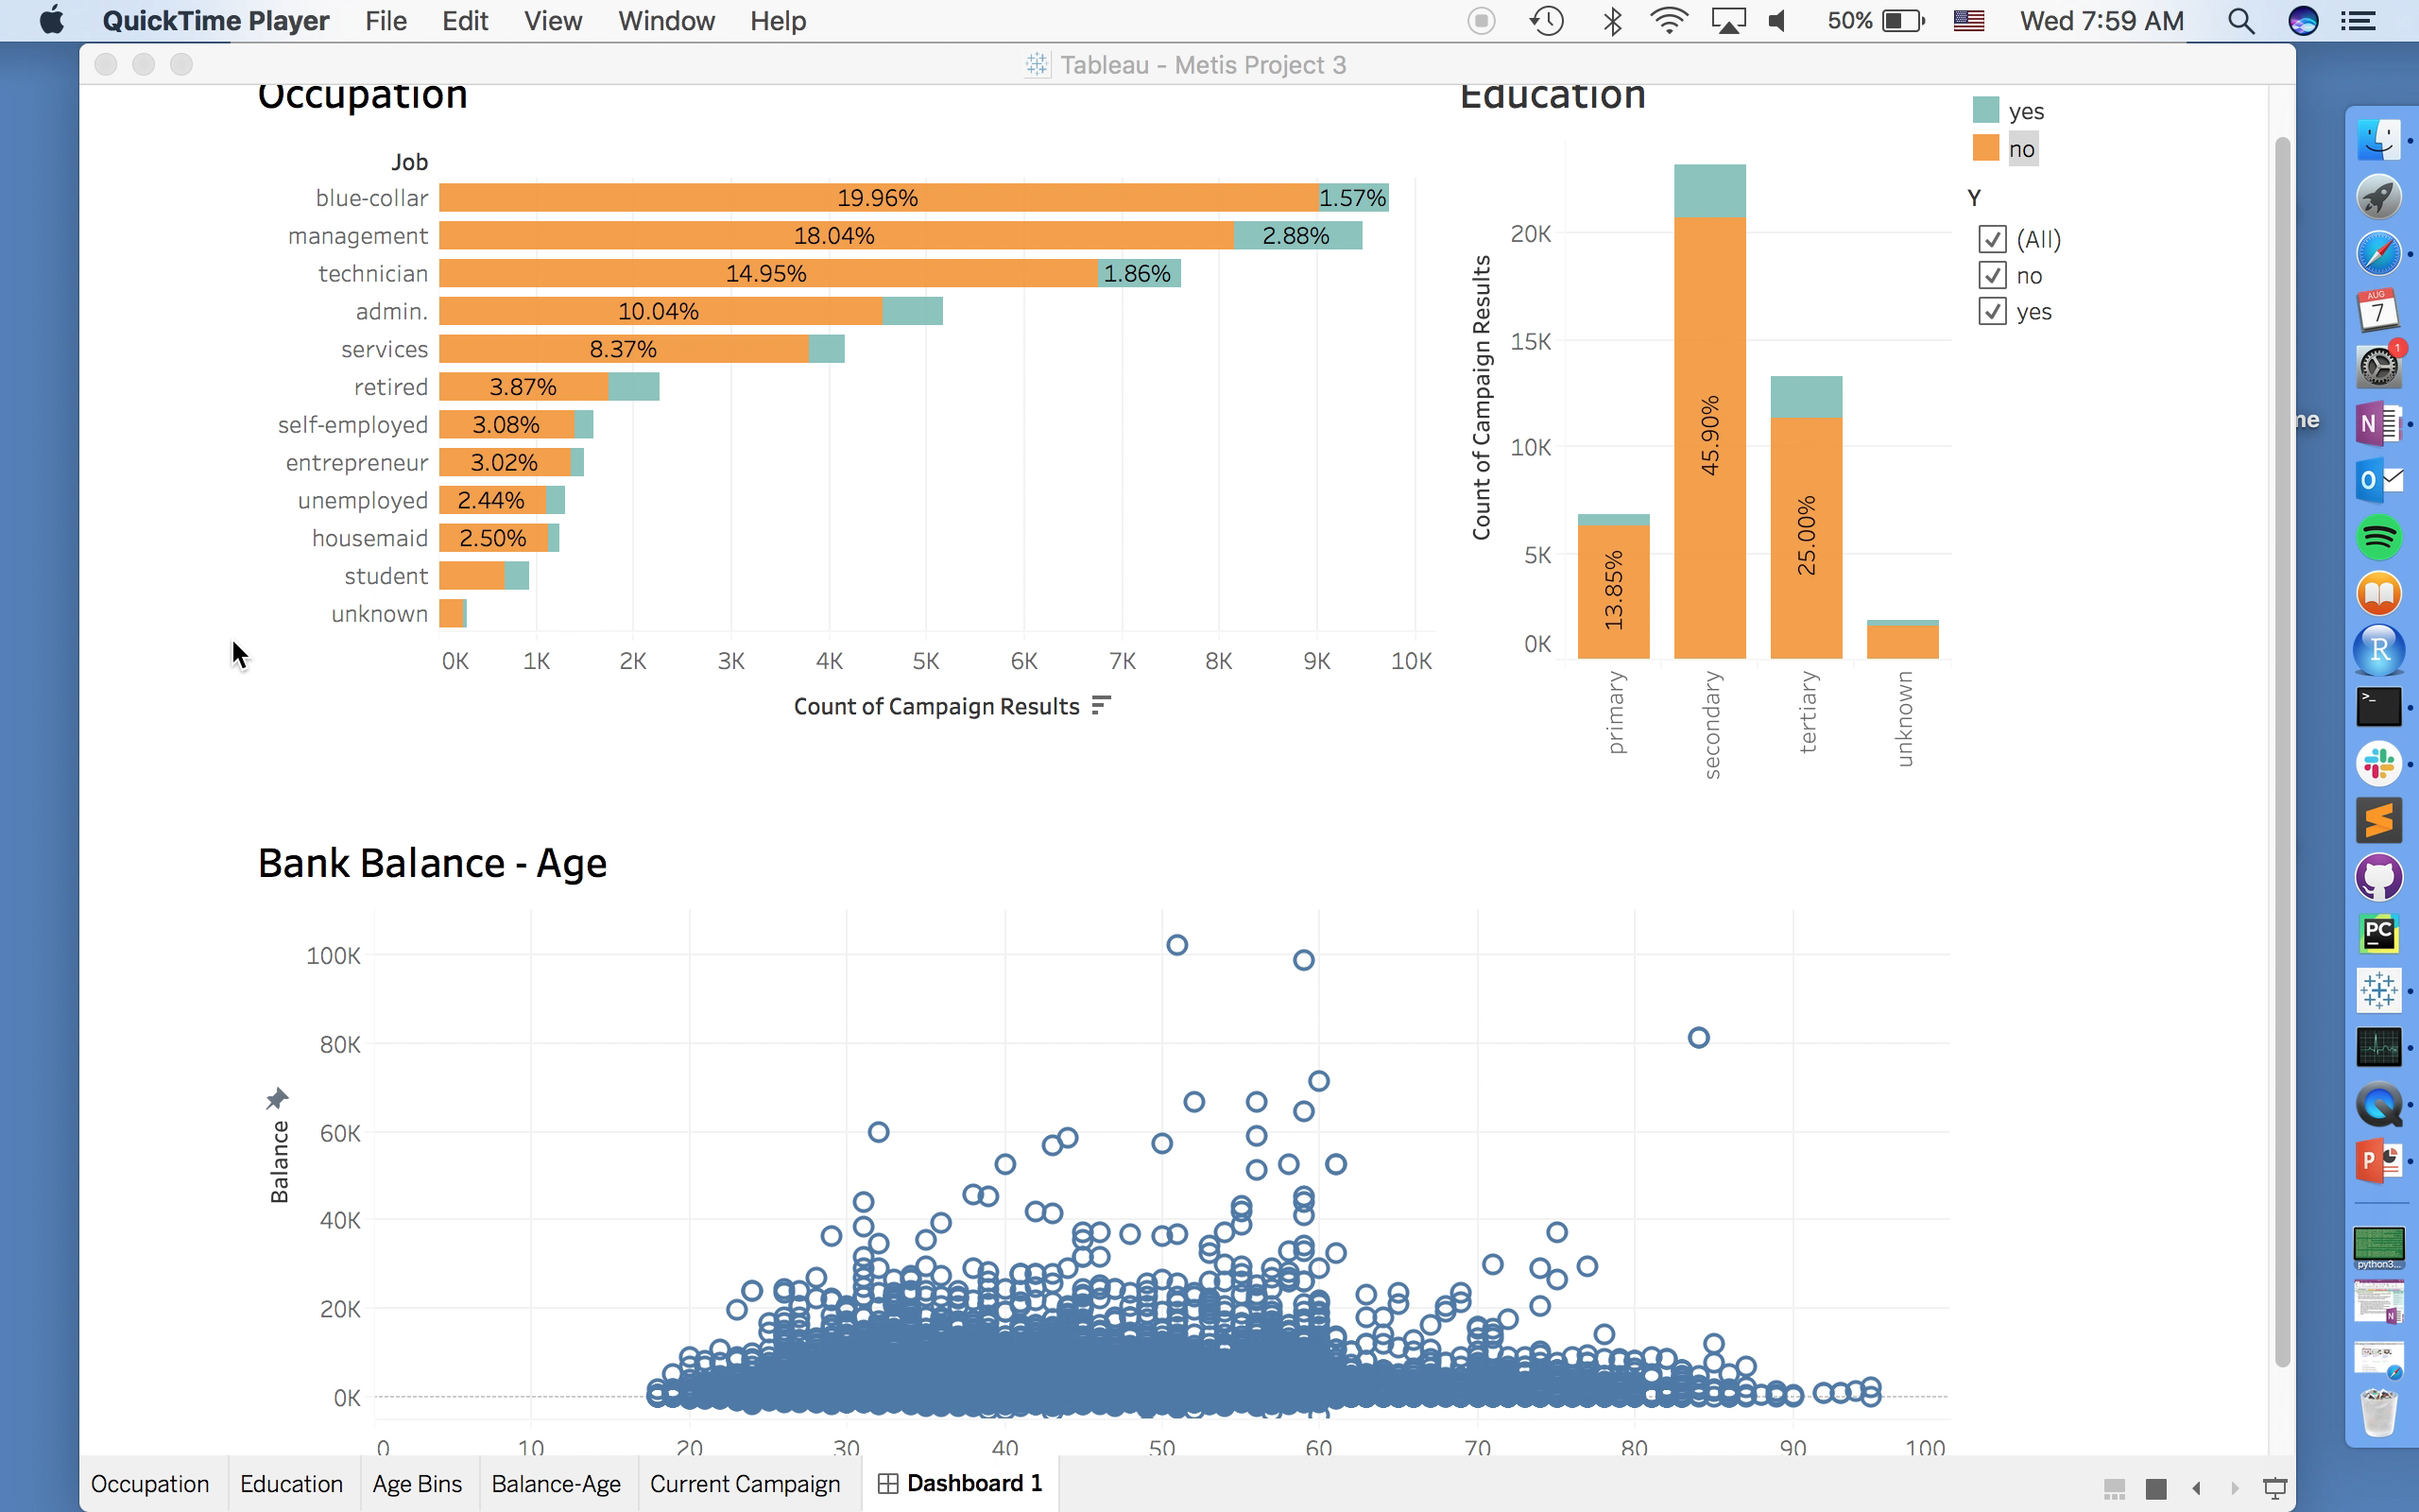
Data Visualization with Tableau

Slide 7
Business Suggestion
Age: Target relatively older age people (conservative investment)
Marital: Target more on married people
Balance: Prefer clients with more money in their account
Campaign: balance number of contacts within campaign
Notes:
pdays: number of days that passed by after the client was last contacted from a previous campaign
campaign: number of contacts performed during this campaign and for this client (numeric, includes last contact)

Slide 8

THANKS

